Slide 1
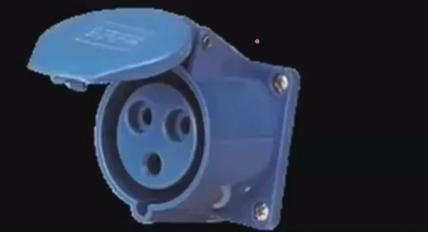
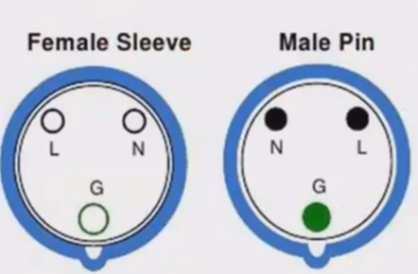
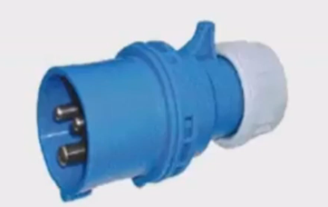
Connectors for Slow Charging and AC Fast Charging
IEC 60309 Female Connector
IEC 60309 Male Connector

Slide 2
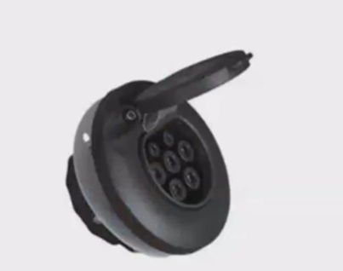
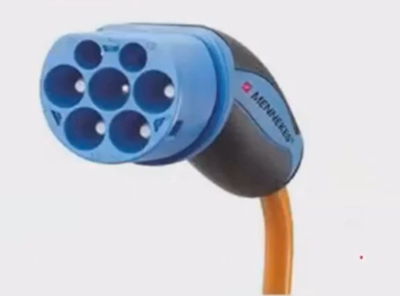
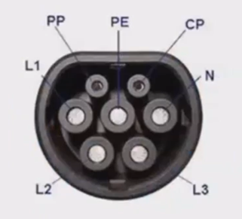
IEC 62196 – Type 2 Female Connector
IEC 62196 – Type 2 Male Connector

